Slide 1
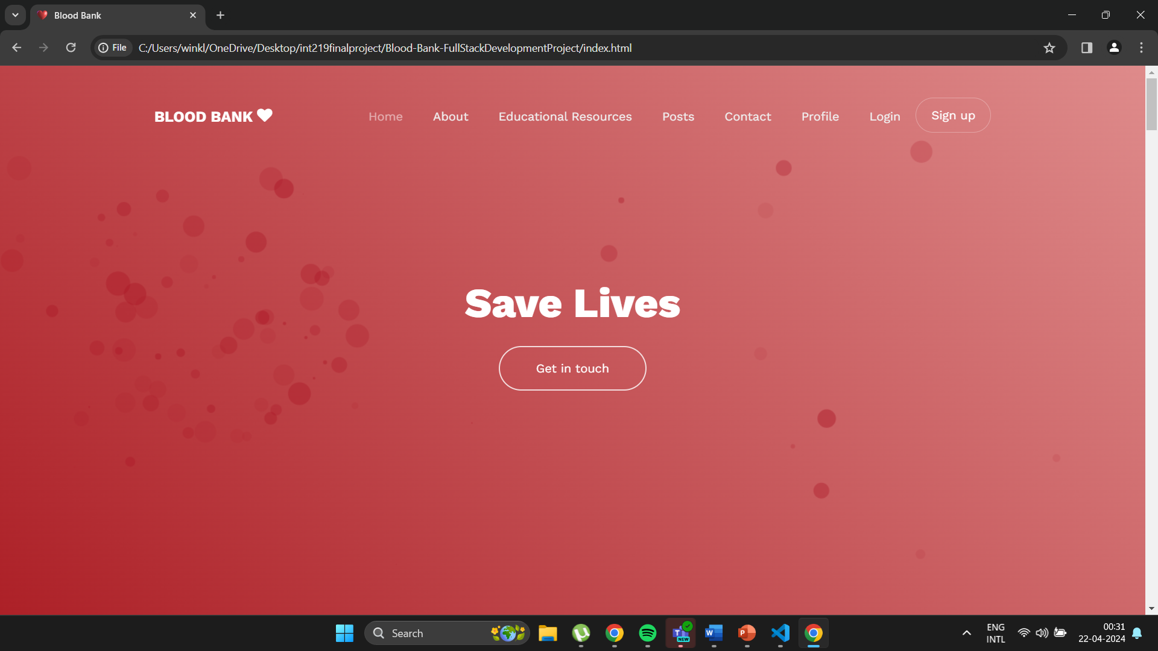
LANDING PAGE

Slide 2
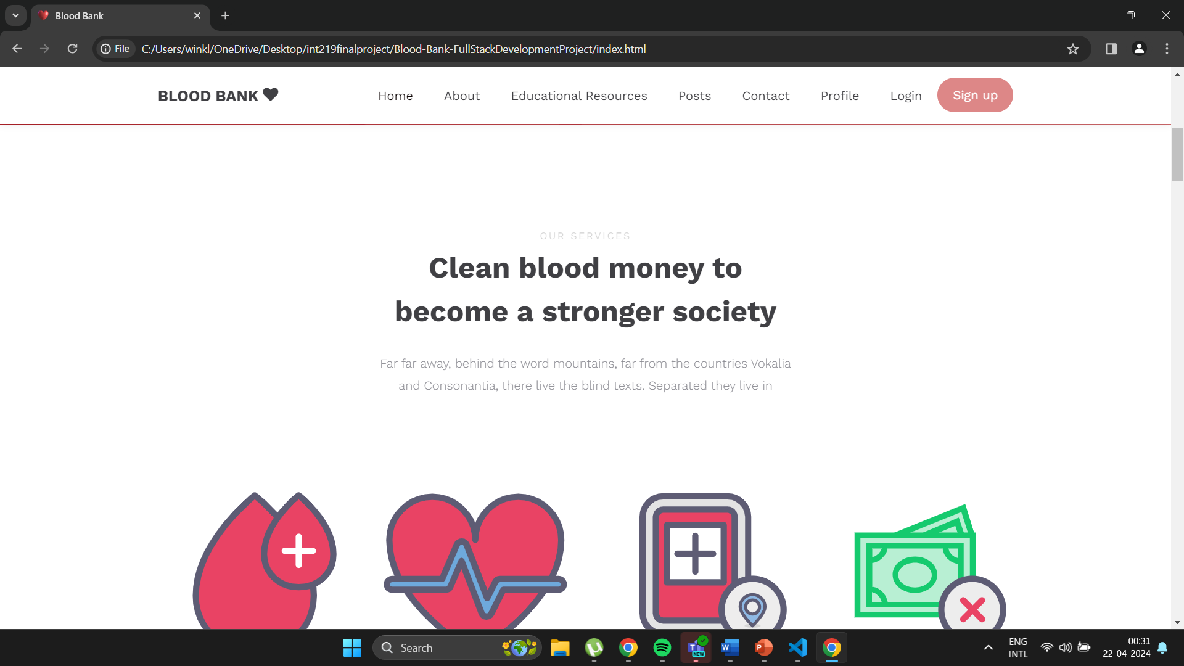
FRONT PAGE AFTER SCROLLING

Slide 3
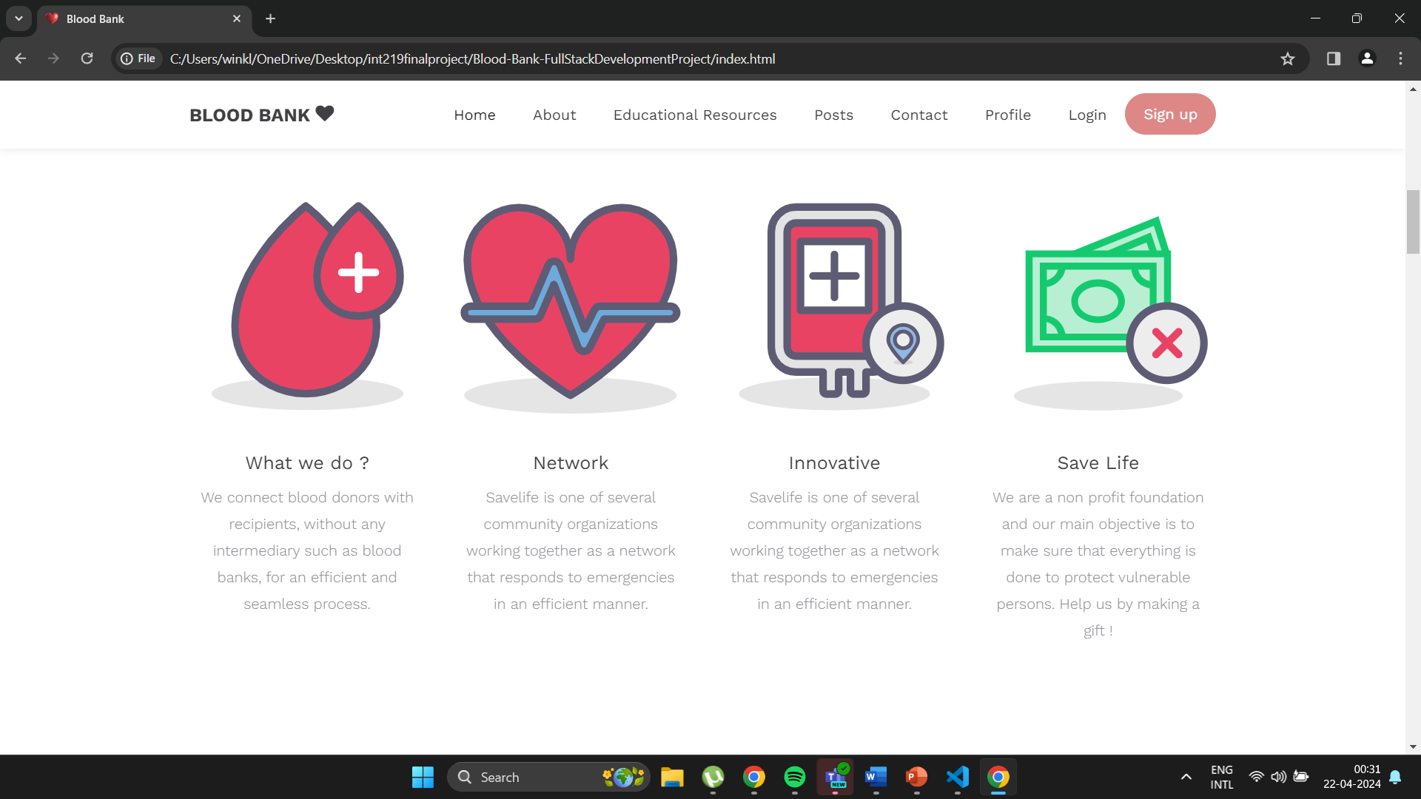
SOME OF THE INFORMATION DISPLAYED ON FRONT PAGE

Slide 4
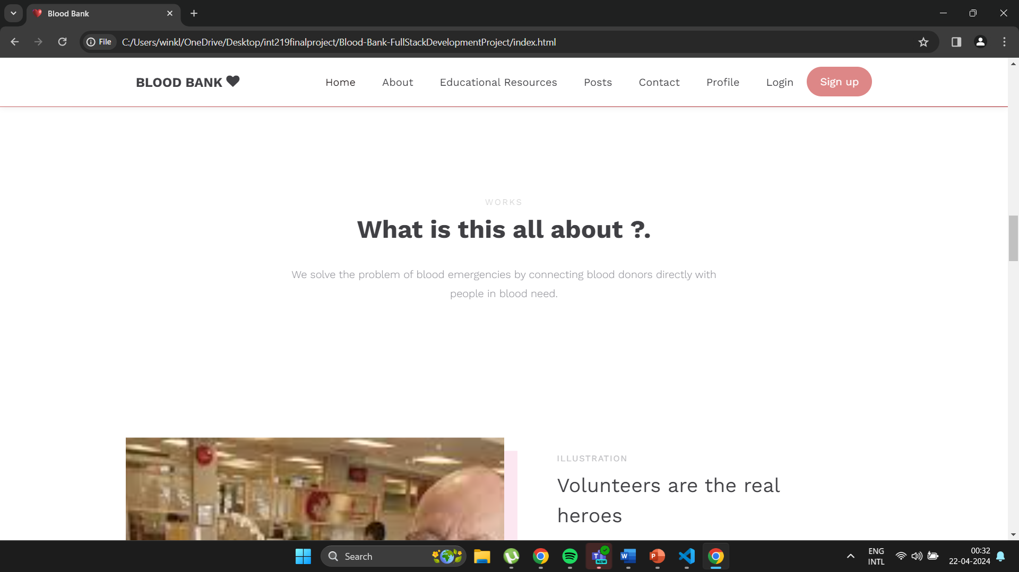
SOME MORE INFORMATION ON LANDING PAGE

Slide 5
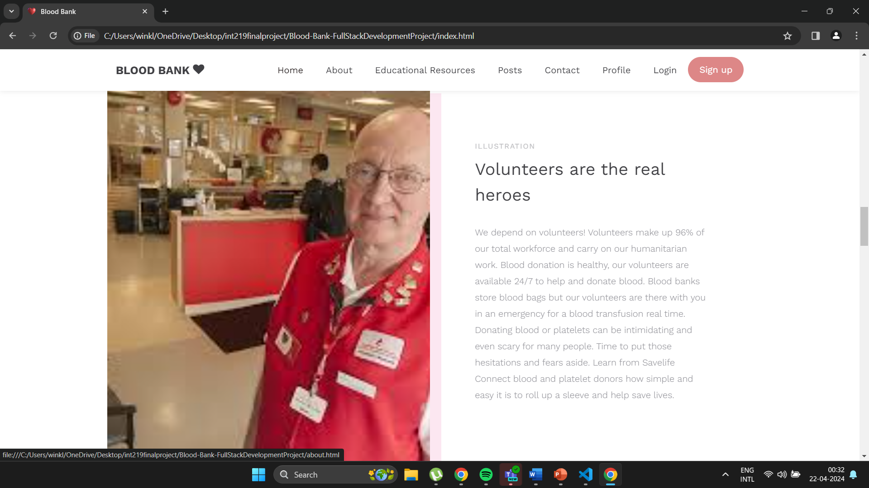
VOLUNTEERS

Slide 6
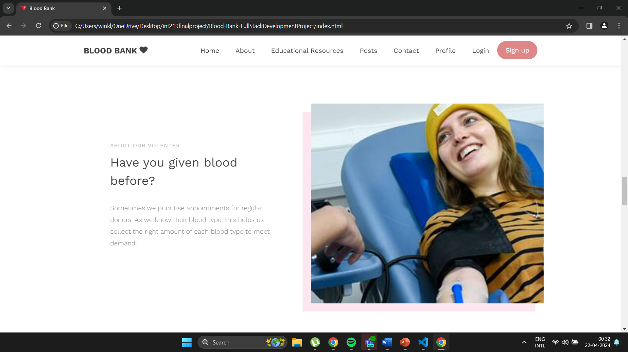
MOTIVATE PEOPLE FOR BLOOD DONATION

Slide 7
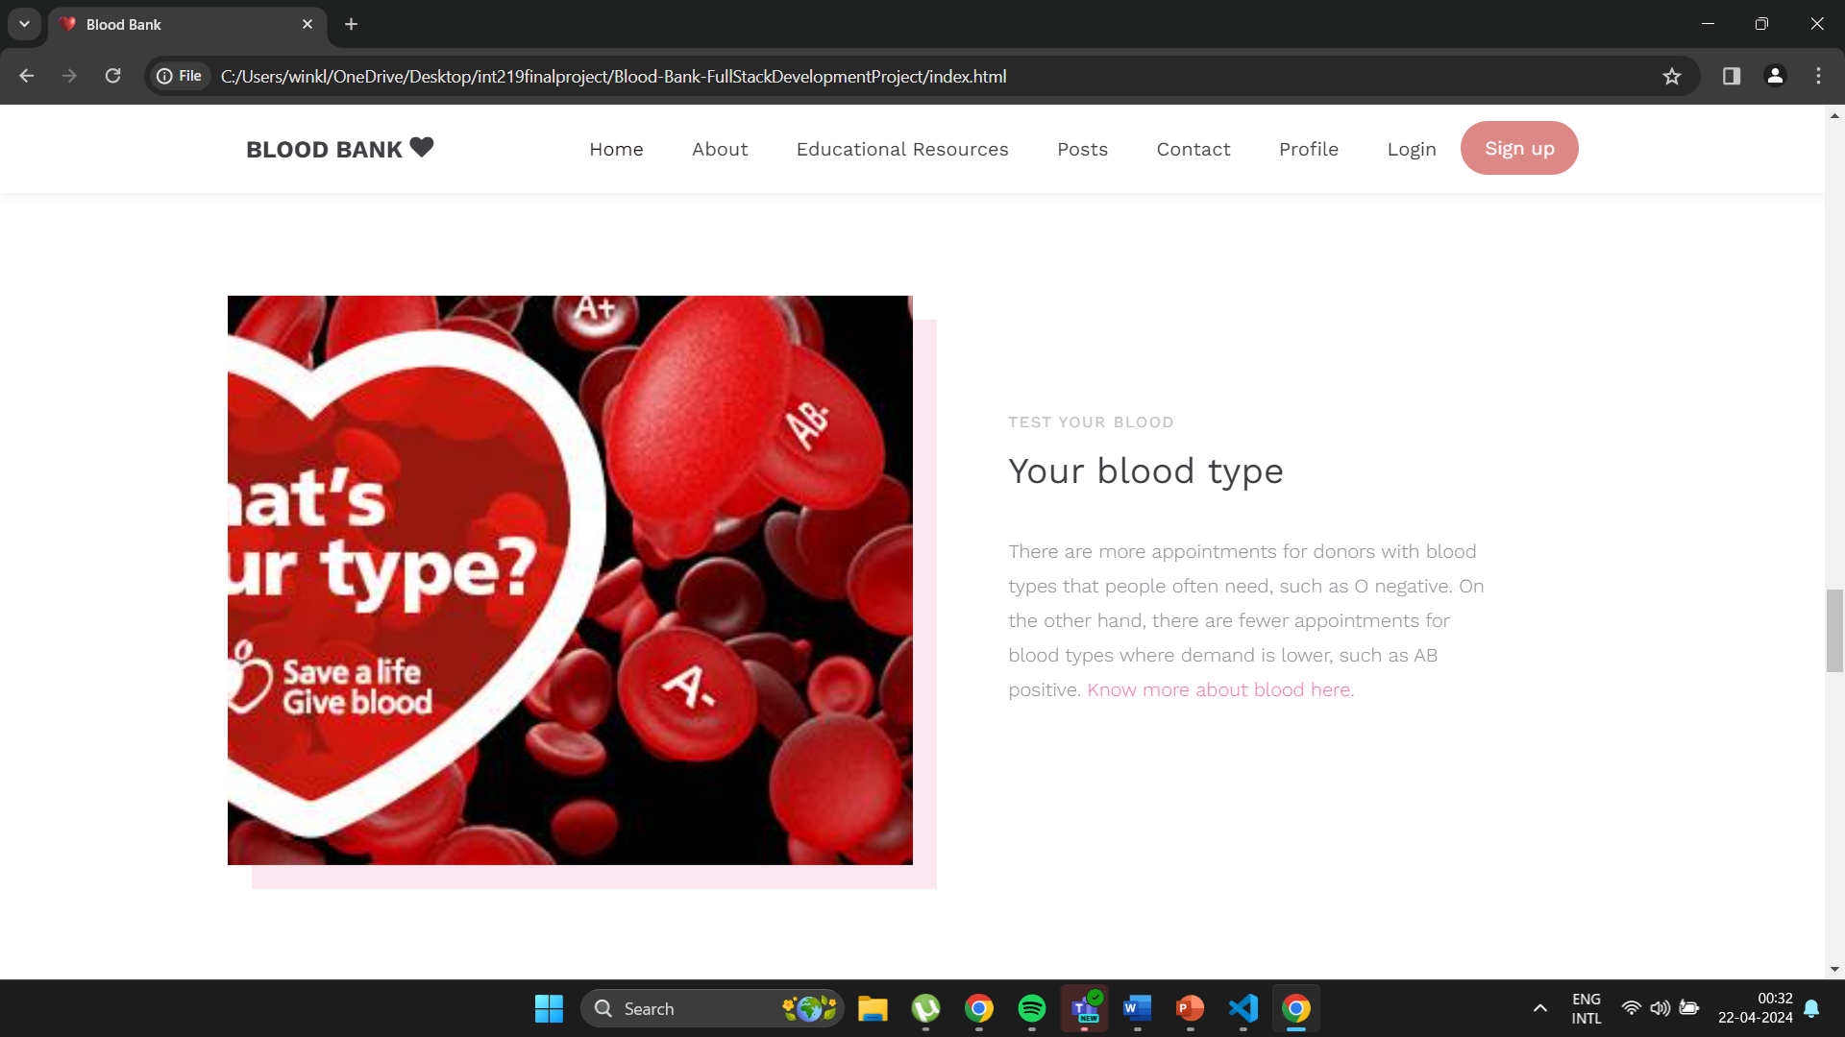
BLOOD AWARENESS

Slide 8
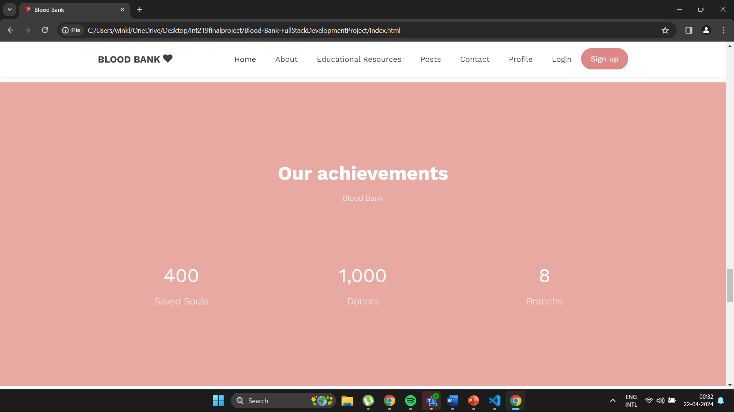
DISPLAY FOR RECORD

Slide 9
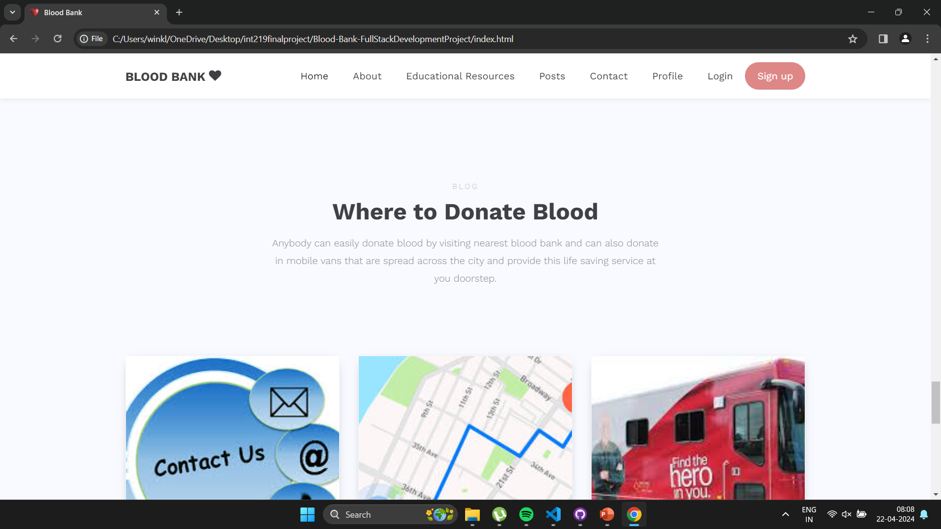

Slide 10
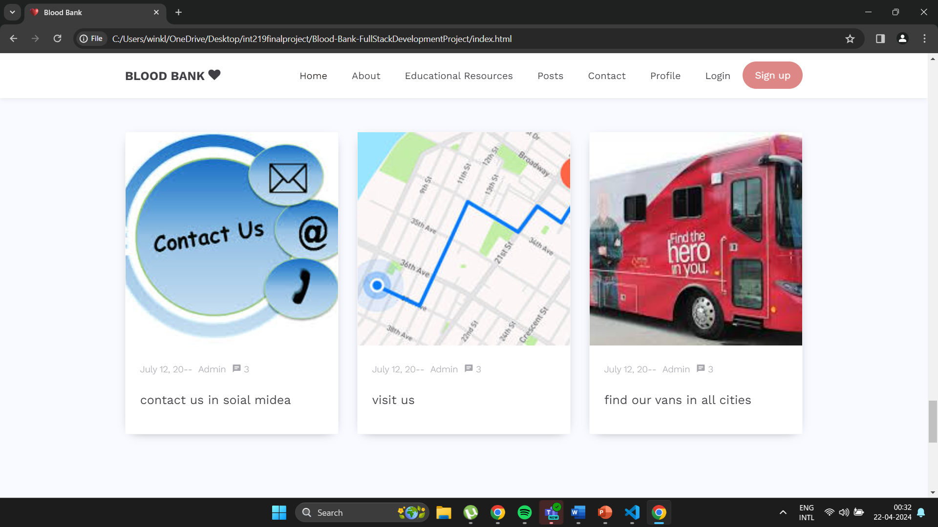

Slide 11
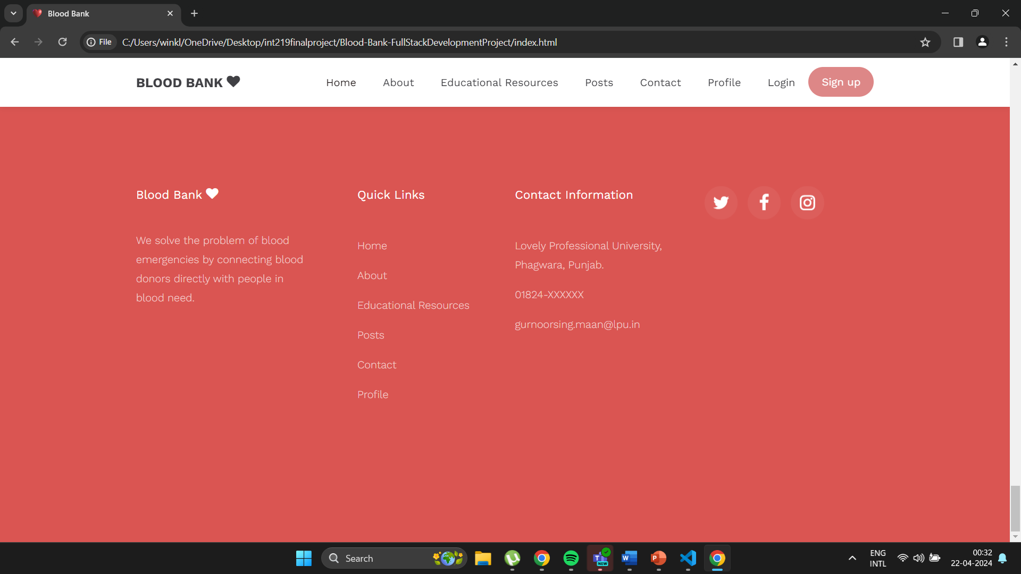
FOOTER OF THE WEBSITE

Slide 12
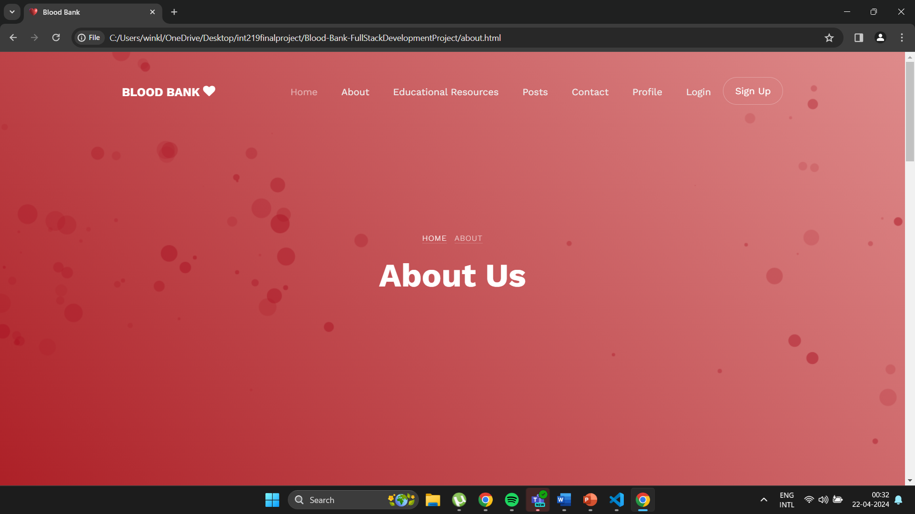
ABOUT US PAGE

Slide 13
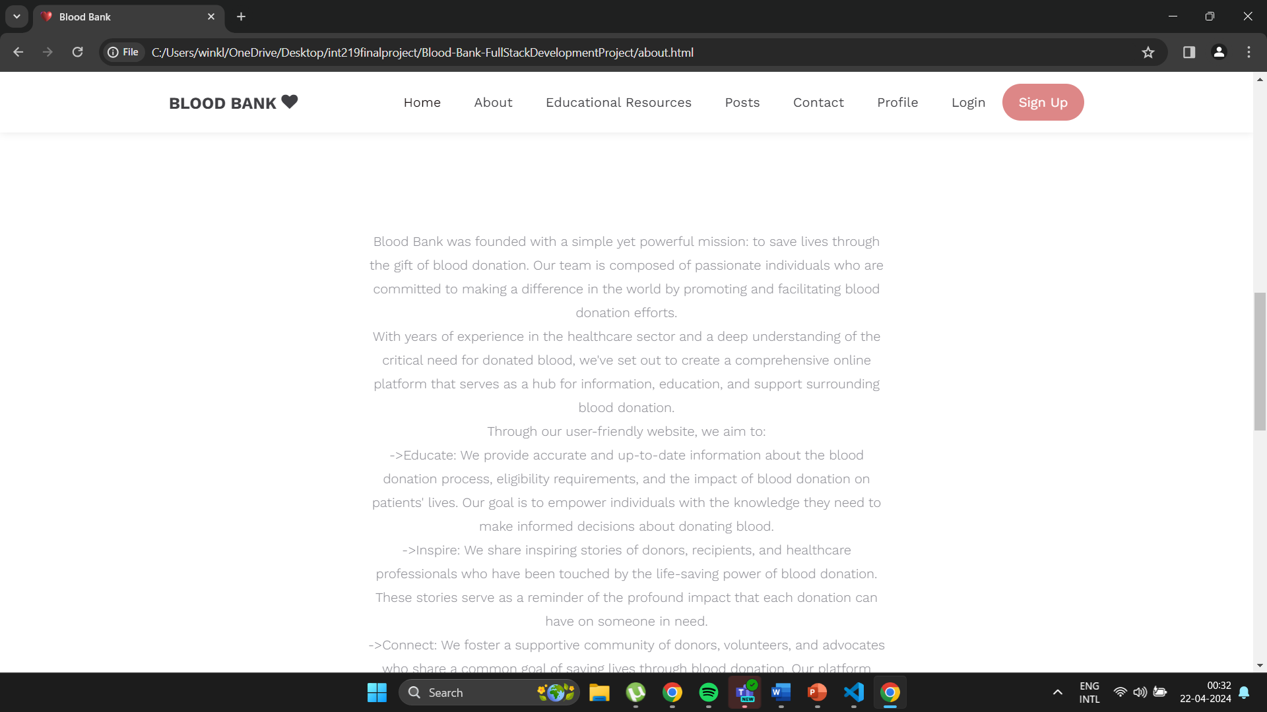

Slide 14
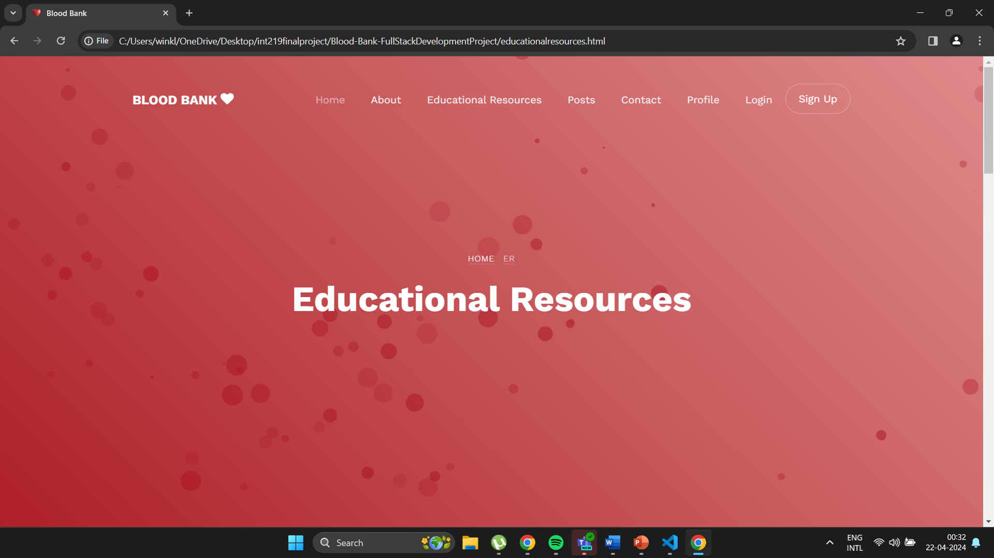
EDUCATIONAL RESOURCES PAGE

Slide 15
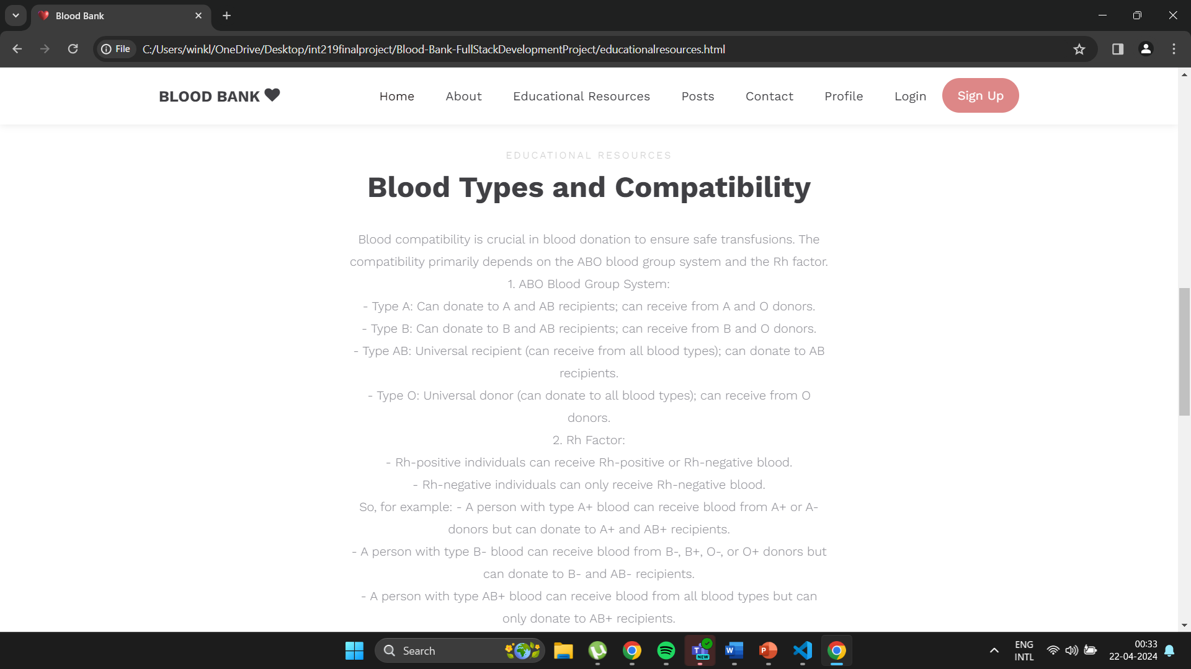

Slide 16
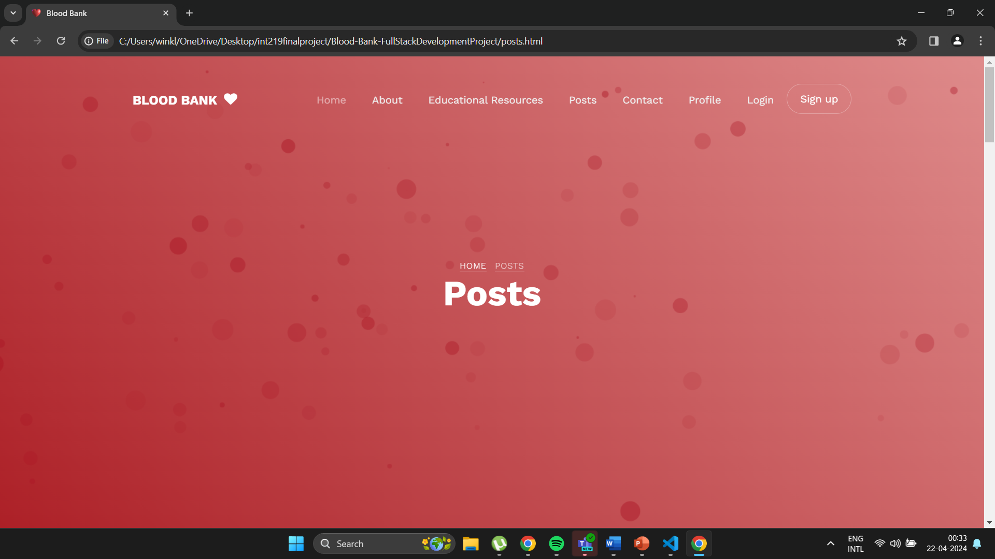
POSTS PAGE

Slide 17
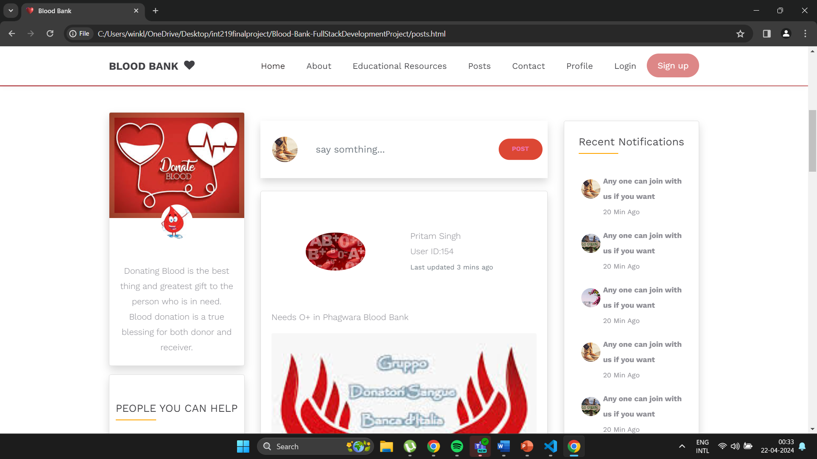
EXAMPLE OF HOW POSTS PAGE WILL LOOK LIKE

Slide 18
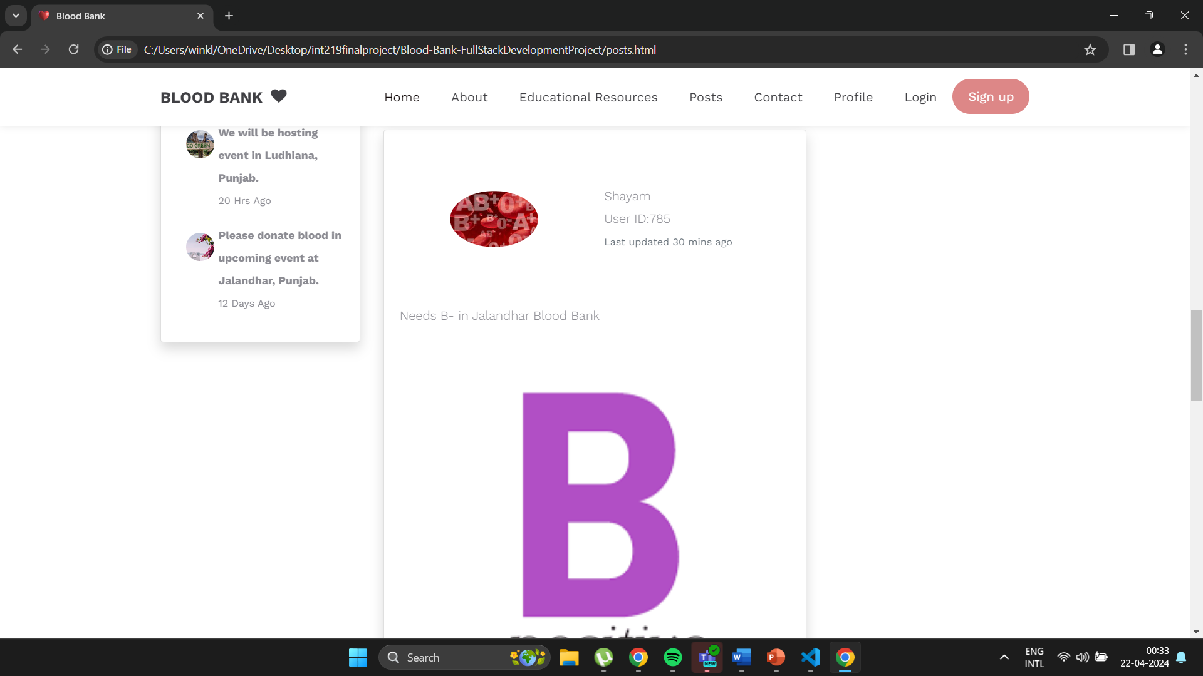
A POST ON THE PAGE

Slide 19
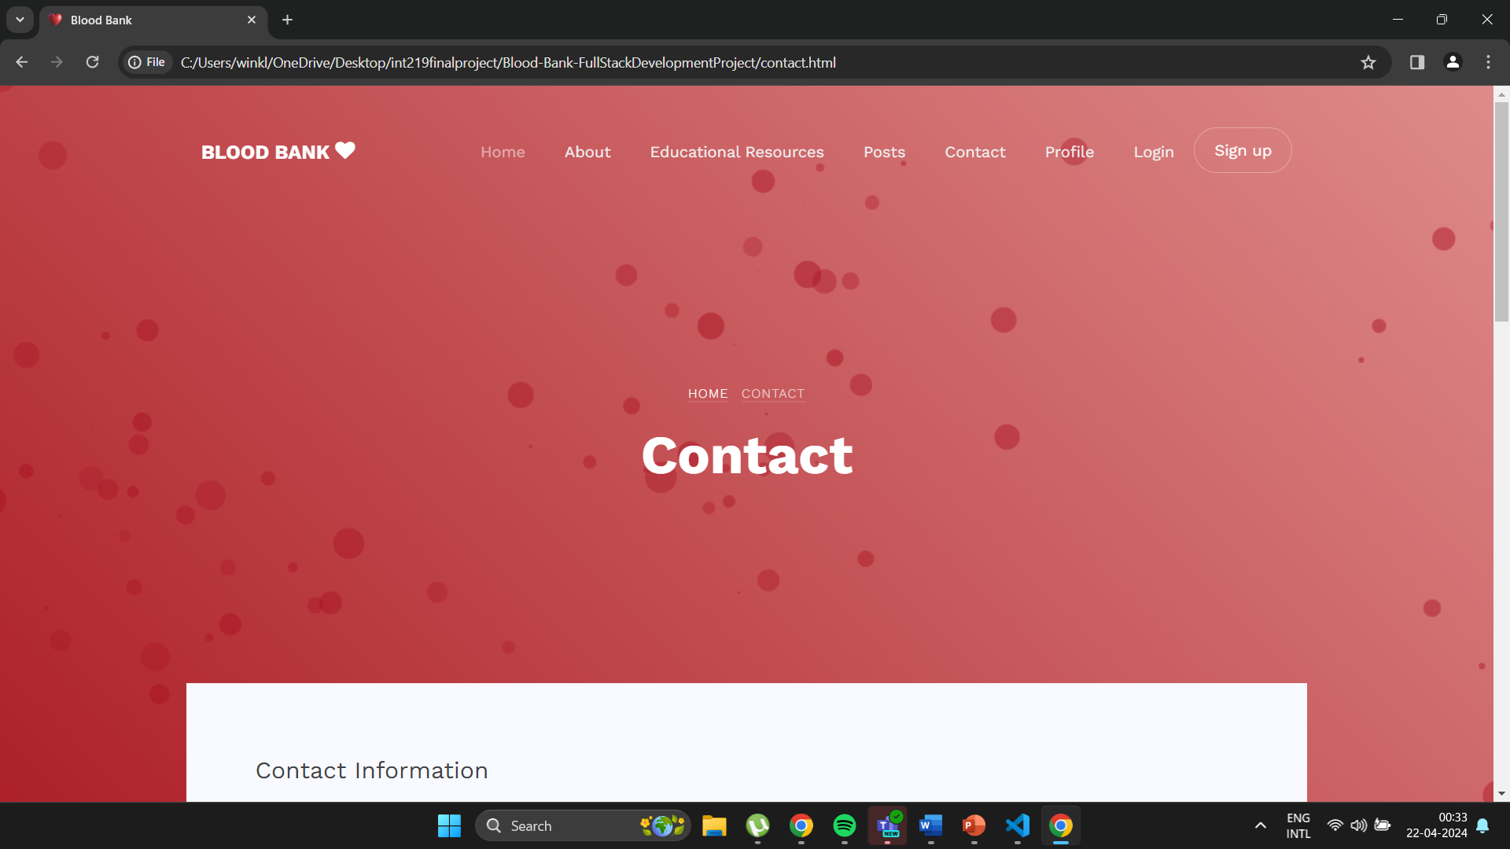
CONTACT US PAGE

Slide 20
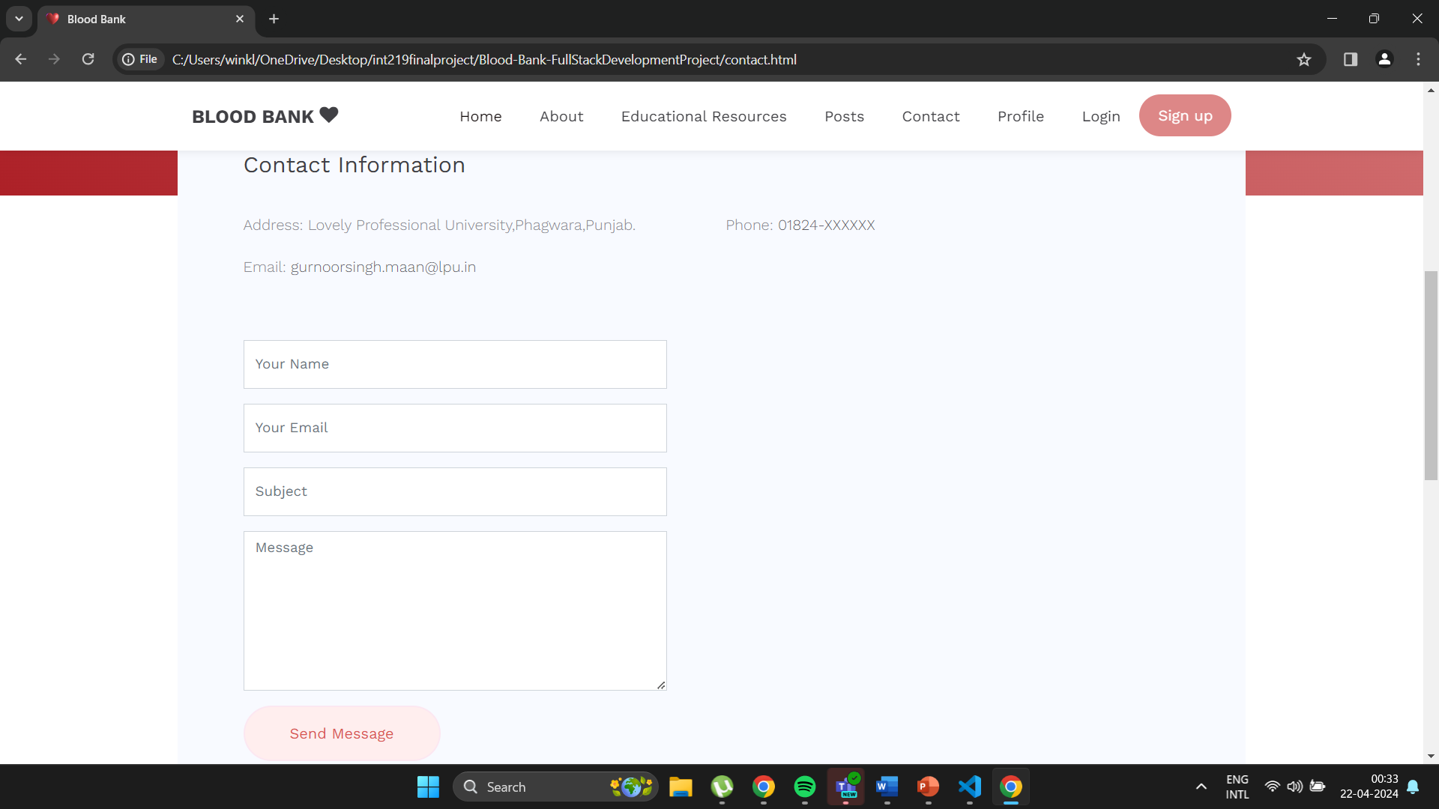
CONTACT FORM

Slide 21
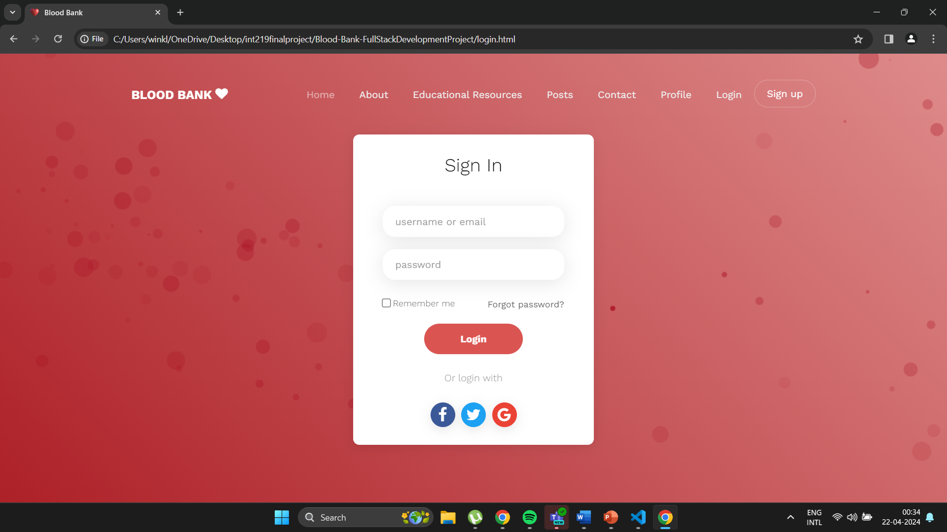
SIGN-IN PAGE

Slide 22
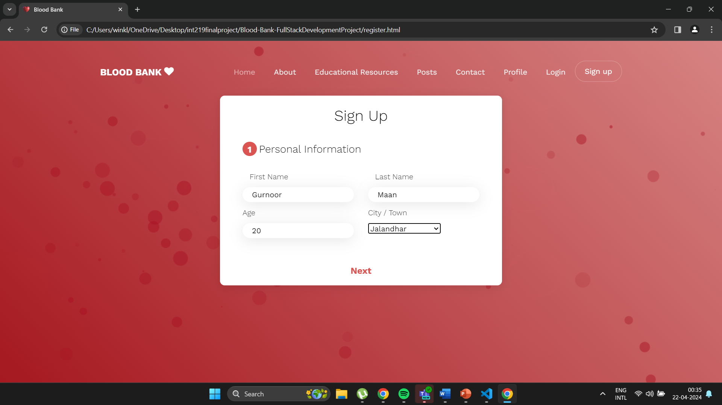
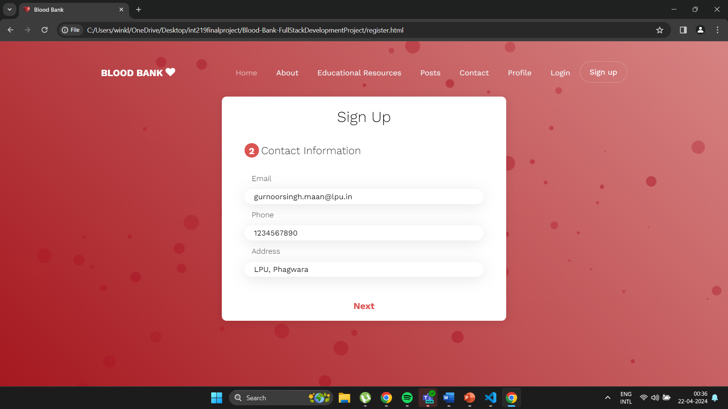

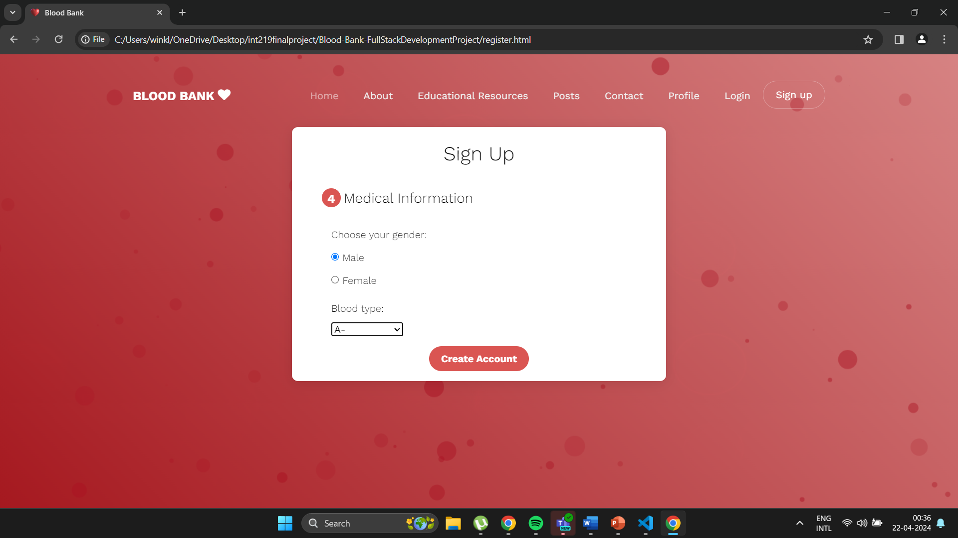
SIGN-UP PAGE STEPS

